Slide 1
European Energy transition
Policies and Technologies
07.09.17
Alessandro Provaggi
Head of DHC+ at EUROHEAT & POWER

Slide 2


Slide 3
Why do we need this energy anyway?
electricity
transport
heat
Notes:
Let’s go step by step

Slide 4

How do we want to be seen?
National Plans

Slide 5

Using heat from the metro?
The heat source is a London Underground ventilation shaft located on City Road where 18-28 degrees Celsius air is exhausted to the atmosphere.
Waste heat to be exploited by heat pumps, which can capture the waste heat, upgrade it to approximately 80 degrees Celsius and then delivered via DHC.
Source: Ramboll

Slide 6

Using heat from the supermarkets?
Some Danish supermarkets
send surplus heat to the district
heating networks
Example of SuperBrugsen
in Høruphavd reducing CO2
emissions by 34%
Source: Danfoss

Slide 7


Using heat from wind and PV ?

Slide 8

Using heat from the data centres?
Data centres by Facebook, Google and Apple in Denmark will increase the country’s power consumption by 11% by 2022
The consumption levels of
data centres are in fact booming
And so huge amount of excess heat
Example:
Apple heating for 100,000 citizens
Notes:
more cost-effective & less carbon-intensive #heating & #cooling than individual heating
IEA towards urban energy systems

Slide 9
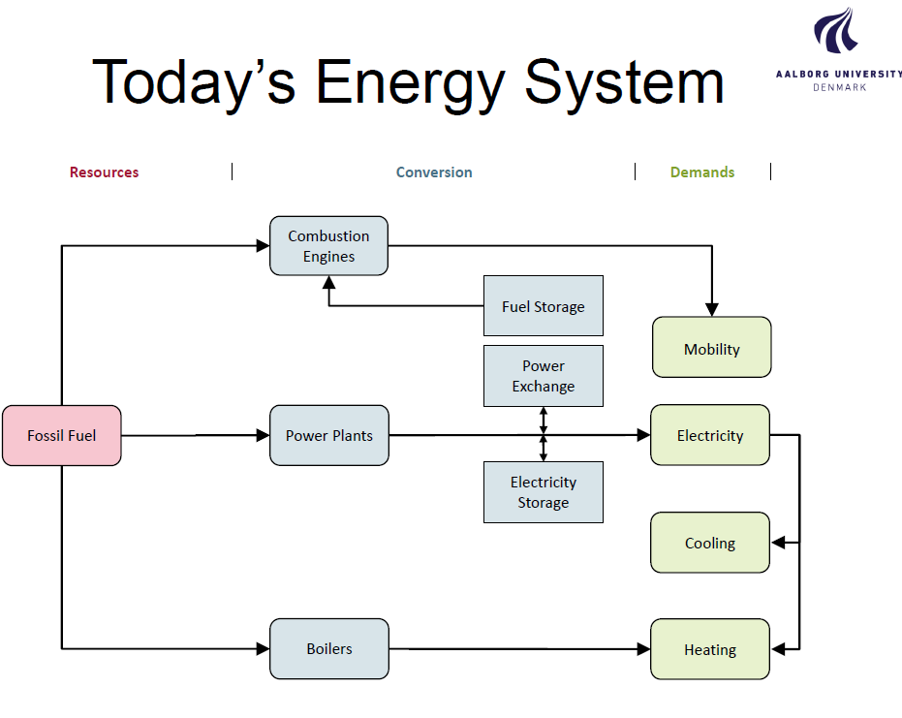

Slide 10


Slide 11
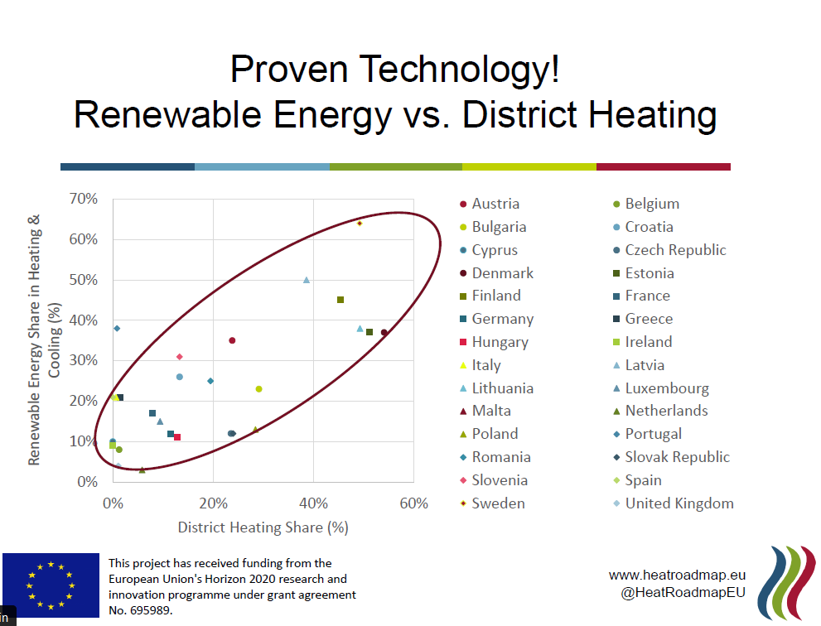

Slide 12
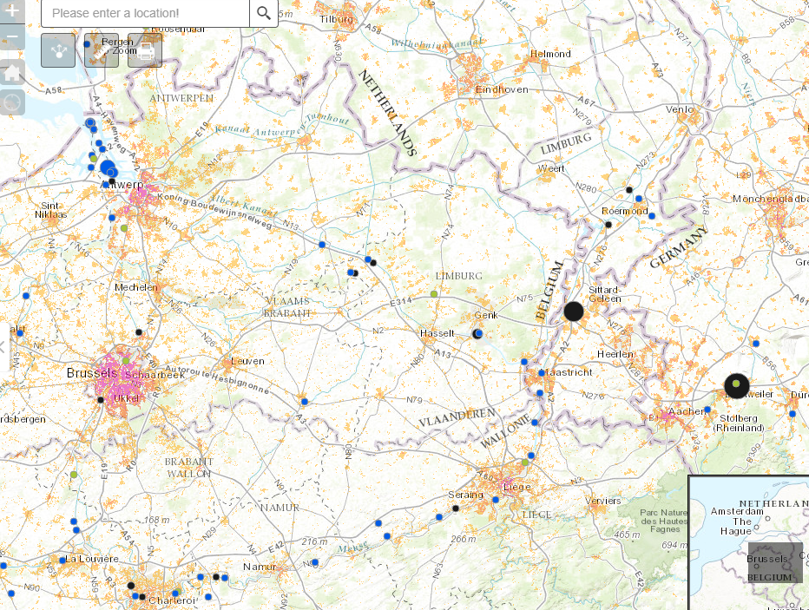

Slide 14
The EU’s Heating and Cooling Strategy
Heating and cooling will remain the biggest demand in 2050
Current reliance on ‘obsolete fossil-fuel boilers’ is unsustainable
A shift to reliance on RES and excess heat is possible and necessary
District heating will have a vital role to play in supply green heat and enabling integration of energy system!

Slide 15
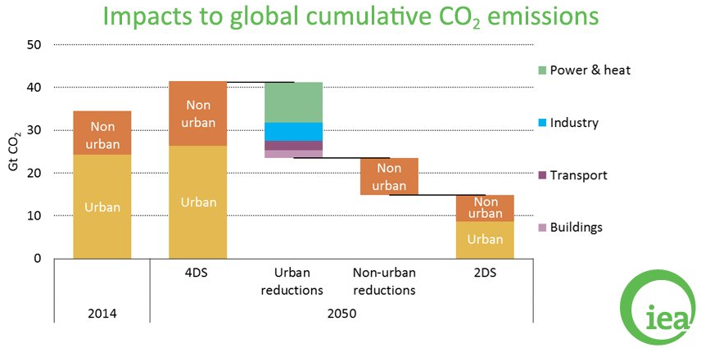
“Cities must take the lead in the transition to a low-carbon energy sector” (IEA)

Slide 16
THANK YOU
WWW.EUROHEAT.ORG

